Slide 1


http://www.comp.nus.edu.sg/~cs1010/
UNIT 2
CS1010 Computing Environment

Slide 2
Unit 2: CS1010 Computing Environment
Types of Programs
Program Development
Programming Environment
sunfire – a UNIX machine
vim – a text editor
File transfer

Slide 3
Types of Programs
Machine code
Assembly code
High-level language program
Program to which computer can respond directly. Each instruction is a binary code that corresponds to a native instruction.
Eg: 0001001101101110
Low-level language with strong (generally one-to-one) correspondence between assembly code and machine code instructions.
Eg: MIPS (add t1, t2, t3)
Requires translation
Detailed knowledge of the machine is not required. High level of abstraction. Ease of writing and understanding.
Eg: Java, C, C++, Python.

Slide 4
Translation of Programs
High-level language programs (eg: C) cannot be executed directly by the computer
Require a translation process called compilation
A special program called compiler is used
The original C program is called the source code
The compiled program is the executable code or machine code
In general, executable codes generated on a certain machine cannot be executed on another machine with a different architecture
The source code needs to be compiled on the new machine

Slide 5
The Edit, Compile and Execute Cycle
Compile
Execute
Edit
Use a compiler to translate the source code into executable
Use an editor to create/modify the source code
Execute/run the executable code
Process is iterative

Slide 6
Computer Environment

Slide 7


Romance of the Three Kingdoms

Slide 8
Romance of the Three Kingdoms

Slide 9
CS1010 Programming Environment (1/2)
UNIX system – the sunfire server
Every SoC student or student taking an SoC programming module can apply for a UNIX account
To login to sunfire server, you need your SoC UNIX account user-name and password.
If you don’t have a UNIX account yet, go to this link to create one (same link if you have forgotten your UNIX password):
https://mysoc.nus.edu.sg/~newacct

Slide 10
CS1010 Programming Environment (2/2)
You can do many things with your sunfire account:
Eg: Your account comes with paper quota
see https://docs.comp.nus.edu.sg/node/1732 for your print quota allocation
Some treat their sunfire account as a backup harddisk
Refer to SoC Computing Facilities web page for more general information
https://docs.comp.nus.edu.sg/cf/

Slide 11


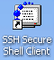

© NUS
sunfire UNIX server
or
SSH/Xshell are programs to allow users to access a remote host over a network.
To download SSH for your home use, go to http://www.comp.nus.edu.sg/~cs1010/2_resources/online.html
Intro Workshop - 11

Slide 12
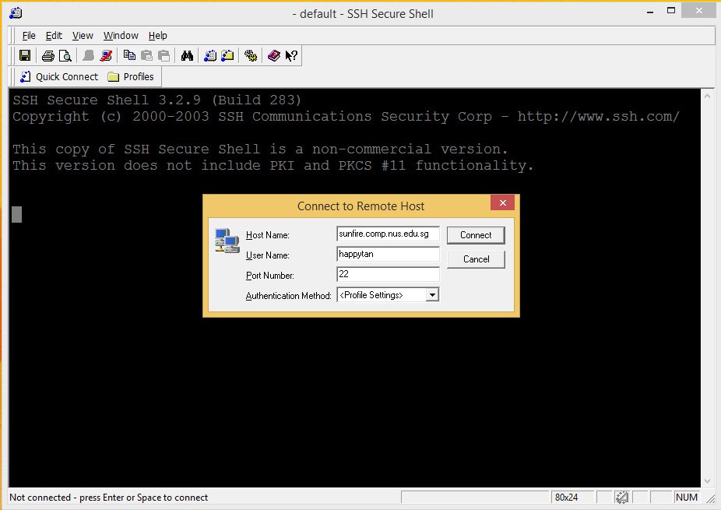
Logging into sunfire (1/2)
1. Look for the SSH Secure Shell Client icon or Xshell icon on your desktop, and double click on it. We shall assume you are using the former here.
or
Click on “Quick Connect” to get the pop-up window.
Enter “sunfire” for Host Name if connecting within campus or “sunfire.comp.nus.edu.sg” if connecting from off campus Enter your UNIX id as User Name.

Slide 13


Logging into sunfire (1/2)
1. Look for the SSH Secure Shell Client icon or Xshell icon on your desktop, and double click on it. We shall assume you are using the former here.
or
Click on “Quick Connect” to get the pop-up window.
Enter “sunfire” for Host Name if connecting within campus or “sunfire.comp.nus.edu.sg” if connecting from off campus Enter your UNIX id as User Name.

Slide 14


Logging into sunfire (1/2)
1. Look for the SSH Secure Shell Client icon or Xshell icon on your desktop, and double click on it. We shall assume you are using the former here.
or
Click on “Quick Connect” to get the pop-up window.
Enter “sunfire” for Host Name if connecting within campus or “sunfire.comp.nus.edu.sg” if connecting from off campus Enter your UNIX id as User Name.

Slide 15
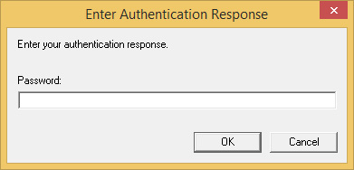
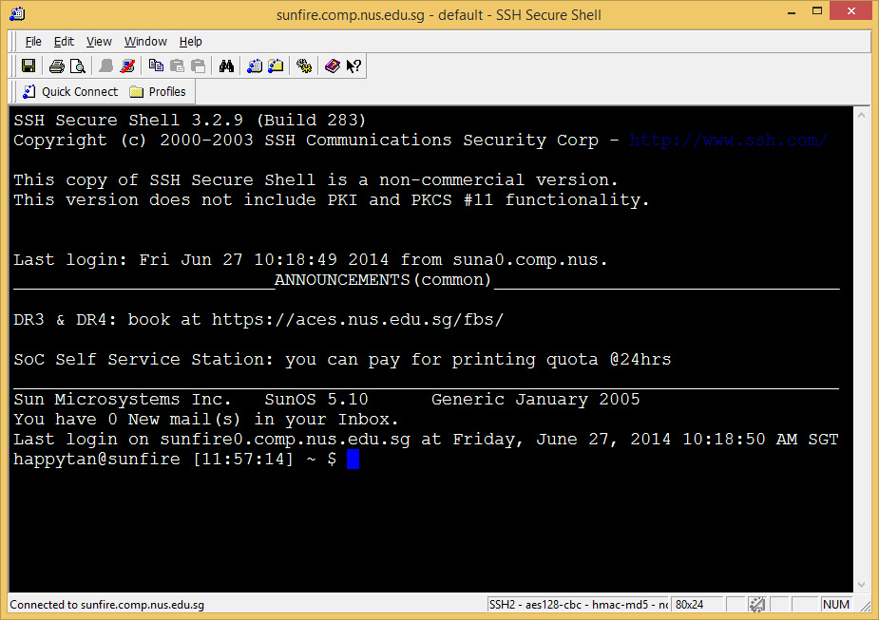
Logging into sunfire (2/2)
3. Enter your UNIX password.
4. Once you log in successfully, you will see this screen (actual display may vary).
5. To log out from your UNIX account, type “exit” or “logout”.

Slide 16
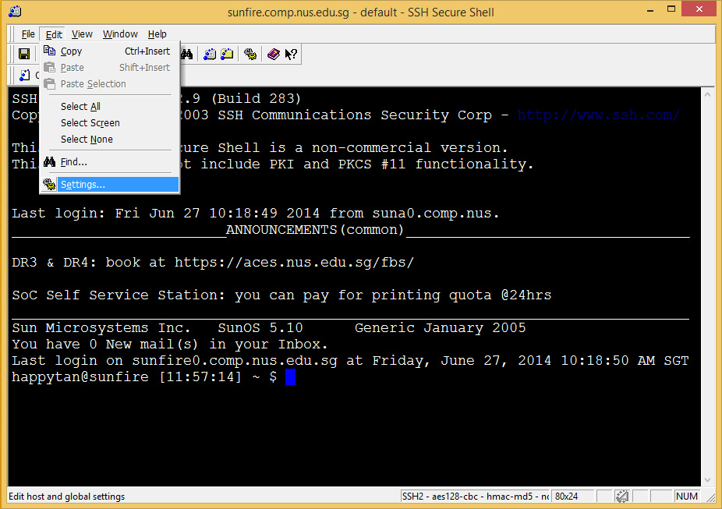
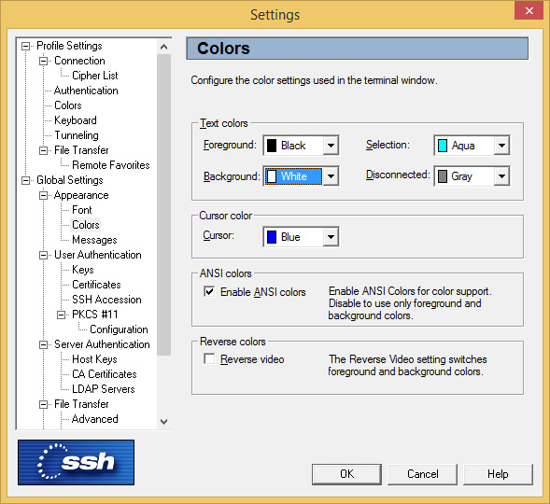
Change settings in SSH
You may change the settings in SSH (eg: font size, background colour, text colour, etc.)
For example, to change background and text colours, click on “Edit” → “Settings” and change the desired settings accordingly.

Slide 17



Slide 18
Trying out some UNIX commands
Type ‘ls’ (list) to list out the files in your directory
You see no list because your account is brand new. There are no files in there.
Type ‘pwd’ (print working directory) to show the pathname of your current directory
An example output: /root/home/h/happytan
ls and pwd are just two UNIX commands.
UNIX commands are case-sensitive.

Slide 19
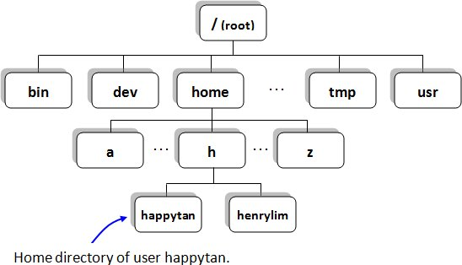
File Directories in sunfire (1/2)
Check out the pathname of your own home directory by typing ‘pwd’
/home/h/happytan

Slide 20
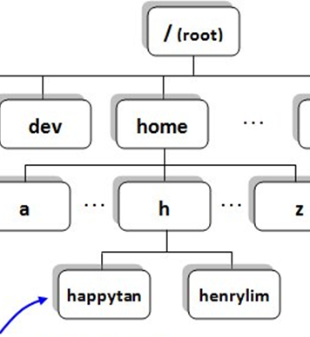

File Directories in sunfire (2/2)
When you log in, you are automatically placed in your home directory.
You are allowed to create/modify/remove files or subdirectories only under your home directory.
/root/home/h/happytan

Slide 21
File Directories in sunfire (2/2)
Earth
Singapore
Clementi Ave 3
Block 430
/root/home/h/happytan

Slide 22

Setting up your UNIX account
As your new account is currently bare, run the following set-up to configure your account:
~cs1010/workshop/setup
(enter y when prompted)
source .bashrc
(no response from the system is good news!)
(1) does the following in your home directory
Creates a ‘c’ subdirectory and puts a few C programs into the ‘c’ subdirectory
Copies a number of system files into the home directory, including .vimrc (vim configuration file)
You need to do this only ONCE.

Slide 23
Basic UNIX Commands (1/4)
In UNIX, typically you do a lot of typing but much less mouse clicking, compared with other operating systems like Windows
UNIX commands are case sensitive
Practice is the best way to recognize UNIX commands. Gradually you will be more and more familiar with UNIX commands – so don’t worry too much at the beginning
In sunfire, you can use the up ↑ and down ↓ arrows to select (and optionally modify) a previous command in the command log

Slide 24
Basic UNIX Commands (2/4)
Following the “Getting Started with UNIX and CodeCrunch” document (http://www.comp.nus.edu.sg/~cs1010/labs/2016s1/intro_lab/gettingStarted.html), your lecturer will go through these basic UNIX commands with you in class. (We will introduce CodeCrunch in the next lesson.)
Directory command | Description
pwd | Print Working Directory
ls | LiSt files in current directory
cd | Change Directory
mkdir | MaKe a subDIRectory
rmdir | ReMove an empty subDIRectory
File command | Description
cp | CoPy file
mv | MoVe file, also to rename file
rm | ReMove file
cat | CATenate file (to view a file)

Slide 25
Basic UNIX Commands (3/4)
Command options
Many UNIX commands come with options, preceded by ‘-’
happytan@sunfire [] ~ $ ls
c
The plain ls command
-F prefixes directory name with /
happytan@sunfire [] ~ $ ls -F
/c
-l displays info in long format
happytan@sunfire [] ~ $ ls -l
drwx------ 2 happytan soc06 4096 Jun 27 12:58 c
happytan@sunfire [] ~ $ ls -a
. .. .bashrc .vimrc c
-a displays hidden files (files beginning with ‘.’ in their names)
Options may be combined:
ls –al or ls –a –l
happytan@sunfire [] ~ $ ls –al
drwx------ 3 happytan soc06 4096 Jun 30 08:45 .
drwxr-xr-x 215 happytan root 8192 Jun 13 12:58 ..
-rwx------ 1 happytan soc06 434 Jun 27 12:45 .bashrc
-rwx------ 1 happytan soc06 237 Jun 27 12:45 .vimrc
drwx------ 2 happytan soc06 4096 Jun 27 12:58 c

Slide 26
Basic UNIX Commands (4/4)
Help using man command (‘man’ stands for ‘manual’)
Type man command to find out more about a certain command
Eg: man ls
Press <spacebar> to read next screen, or enter ‘q’ to quit.
Filename auto-filling
Provides auto-filling of filenames, handy for very long filenames
Press <tab> for system to fill out the rest of the filename (as much as it can)
happytan@sunfire [] ~ $ cd c
happytan@sunfire [] ~/c $ ls
example1.c example2.c example3.c
happytan@sunfire [] ~/c $ cat e ← press <spacebar> after typing ‘e’ and observe
System managed to fill filename up to ‘example’ and stopped, because there are 3 filenames that begin with ‘example’. Type ‘1’, ‘2’, or ‘3’ and press <tab> for system to fill the whole filename, then press <enter>.

Slide 27
Editing C source codes (1/3)
Compile
Execute
Edit
We use a text editor to create/modify C programs (source codes)
We will use the vim editor
Source code
Editor
produces
eg: vim first.c
first.c
vim is a powerful text editor. It has 2 modes
Command mode: for issuing vim commands
Insert mode: for typing in text
To switch between command mode and insert mode
Type i in command mode to get into insert mode
Press <esc> key in insert mode to get into command mode

Slide 28


Vim is like….
Chopper!!
With different modes!

Slide 29
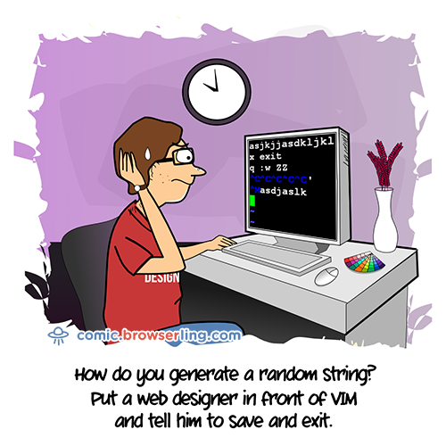
Vim is confusing at first

Slide 30

Vim Quotes
“I fell in love the way you fall asleep: slowly, and then all at once.” – The Fault in Our Stars
In Chinese:
“慢慢來 比較快”
I will guarantee that typing in vim is faster then using a mouse for code

Slide 31
Editing C source codes (2/3)
Compile
Execute
Edit
Use vim to create this C program first.c
#include <stdio.h>
int main(void) {
int a=27, b=6, c;
c = a%b;
printf("The value of c is %d.\n", c);
return 0;
}

Slide 32
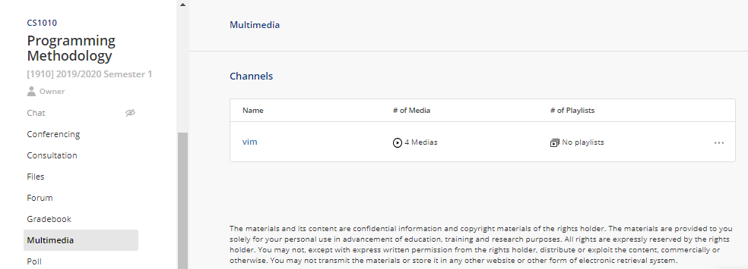
Editing C source codes (3/3)
Compile
Execute
Edit
4 videos on vim are available on IVLE
Luminus → CS1010 → Multimedia → vim
CS1010 “Online” page: http://www.comp.nus.edu.sg/~cs1010/2_resources/online.html
Search the Internet

Slide 33
Compiling C programs (1/3)
Compile
Execute
Edit
We use the C compiler gcc in sunfire
Executable code
Compiler
produces
eg: gcc first.c
a.out
Advisable to add the option –Wall (warnings all) for beginners:
gcc –Wall first.c
If there are compilation errors/warnings, you need to edit the source code first.c again (vim first.c), and re-compile (gcc –Wall first.c), until your code is clear of compilation errors/warnings.
Remember to add option ‘-lm’ if your C program uses math functions
Example: gcc –Wall –lm example1.c
Type ‘ls’ to check that you have the executable code a.out

Slide 34
Compiling C programs (2/3)
Compile
Execute
Edit
The executable file has the default name a.out. However, all filenames in a directory must be unique, hence there can only be one a.out in a directory.
Since you have many C source codes in a directory (eg: example1.c, example2.c, example3.c), you might want to have their corresponding executable files all in the same directory, appropriately named.
Two approaches:
Rename a.out after compilation
Indicate the desired name of the executable file during compilation

Slide 35


Compiling C programs (3/3)
Compile
Execute
Edit
Rename a.out after compilation
happytan@sunfire [] ~/c $ gcc –Wall -lm example1.c
happytan@sunfire [] ~/c $ mv a.out example1
happytan@sunfire [] ~/c $ gcc –Wall example2.c
happytan@sunfire [] ~/c $ mv a.out example2
happytan@sunfire [] ~/c $ gcc –Wall example3.c
happytan@sunfire [] ~/c $ mv a.out example3
Executable files are named example1, example2, example3.
Indicate the desired name of the executable file during compilation using the ‘-o’ option
happytan@sunfire [] ~/c $ gcc –Wall –lm example1.c –o example1
happytan@sunfire [] ~/c $ gcc –Wall example2.c –o example2
happytan@sunfire [] ~/c $ gcc –Wall example3.c –o example3
Be careful not to overwrite the source code accidentally!
The following will replace the source code with the executable file, which is called example1.c now! The source code cannot be recovered!
happytan@sunfire [] ~/c $ gcc –Wall –lm example1.c –o example1.c

Slide 36
Executing C programs
Compile
Execute
Edit
Executing a C program is simple – just type the name of the executable file
To run the executable file example1:
happytan@sunfire [] ~/c $ example1
The distance between the 2 points is 3.61
We have gone through the Edit – Compile – Execute process
Source code
Edit
produces
first.c
eg: vim first.c
Executable code
Compile
produces
a.out
eg: gcc first.c
Program output
Execute
produces
eg: a.out
The value of c is 3.

Slide 37
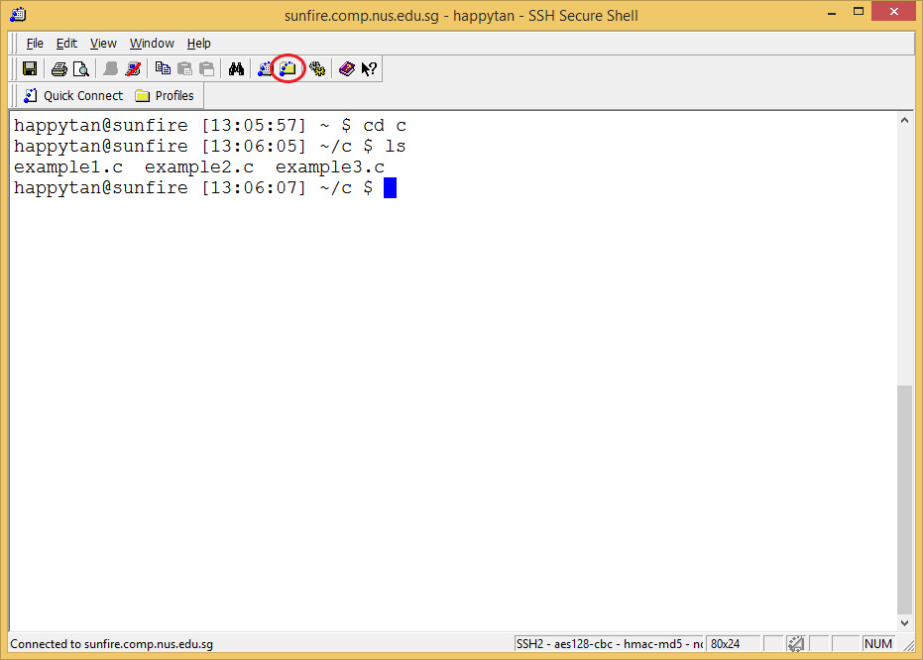
File Transfer (1/2)
To transfer files between your sunfire account and your local computer, click on the SSH Secure File Transfer icon

Slide 38
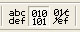
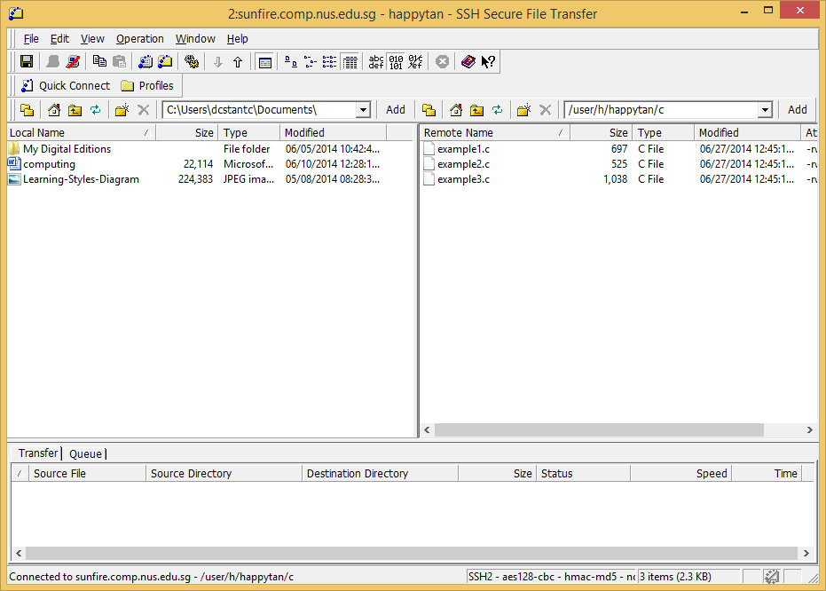
File Transfer (2/2)
Left: your local machine; right: sunfire
Choose the format: ASCII, Binary or Auto
Click on file(s) to transfer, and drag to the destination

Slide 39
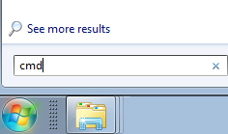
Using Samba Service (1/3)
Samba service allows you to access your sunfire account directory on Windows when you are connected to the SoC network (directly or via VPN).
Enable this service at the following URL https://mysoc.nus.edu.sg/~myacct/services.cgi
Open a command prompt on Windows
Click on the Start button
Type “cmd” in the search box, and press Enter

Slide 40
Using Samba Service (2/3)
Type in the following command
net use <drive> \\stusambahost\<UNIX id>
Replace <drive> with a drive letter of your choice
Replace <UNIX id> with your UNIX id
Example: net use Z: \\stusambahost\happytan
Login with your NUSNET account when prompted
Username: nusstu\<NUSNET id>
Password: <NUSNET password>
You will be able to access your sunfire account directory through the specified drive letter in Windows

Slide 41
Using Samba Service (3/3)
If you are using your own PC,
Turn on SoCVPN @ https://webvpn.comp.nus.edu.sg using a non-Chrome browser (e.g., Firefox)
Use stusambahost.comp.nus.edu.sg in the net use command (instead of just stusambahost)
For a detailed user guide on Samba service, visit https://docs.comp.nus.edu.sg/node/1663

Slide 42
Summary
In this unit, you have
Familiarised yourself with the programming environment
Accessed the sunfire system and learned some basic UNIX commands
Used the editor vim to create/modify your C programs
Used the compiler gcc to compile your C programs
Familiarised yourself with the edit – compile – execute process

Slide 43
End of File

Slide 44
